Slide 1
Synchronization
MODULE 3
Ashok Patade

Slide 2
Clock Synchronization

Slide 3
Physical Clock

Slide 4
Drifting of Clocks

Slide 5
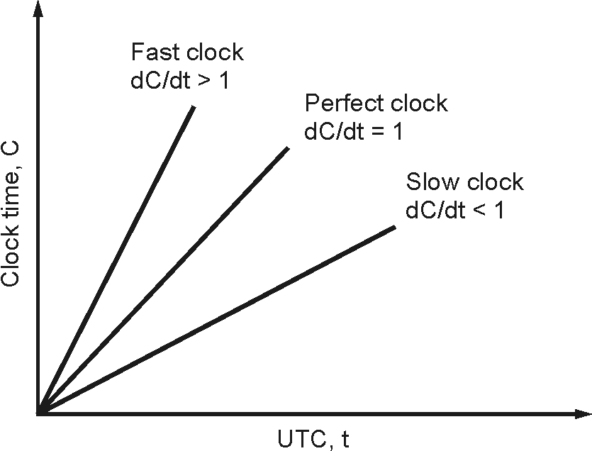
Fig. 3.2.1 : The relation between clock time and UTC when clocks tick at different rates

Slide 6
Issues in Clock Synchronization
A simple method of clock synchronization is that each node must send a request message ‘time=?’ to the real-time server. The node gets a reply message with ‘time=t’. This method has the following issues:
(a) The ability of each node to read another node’s clock value. This can raise errors due to delays in message communication between nodes. Delay can be computed by computing the time needed to prepare, transmit and receive an empty message in the absence of transmission errors and system load.
(b) Time must never run backward since it may lead to the repetition of events or transactions creating disorder in the system. Time running backward is just a perception, not actually it goes backward.

Slide 7
Reasons for Delay in Synchronization
(a) Communication Link Failure :
(b) Fault Tolerance :
(c) Propagation Time :
(d) Non-Receipt of Acknowledgement :
(e) The Bandwidth of the Communication Link :

Slide 8
Clock Synchronization Algorithms
(A) Centralized Algorithms
Passive Time Server
Active Time Server
Berkeley Algorithm

Slide 9
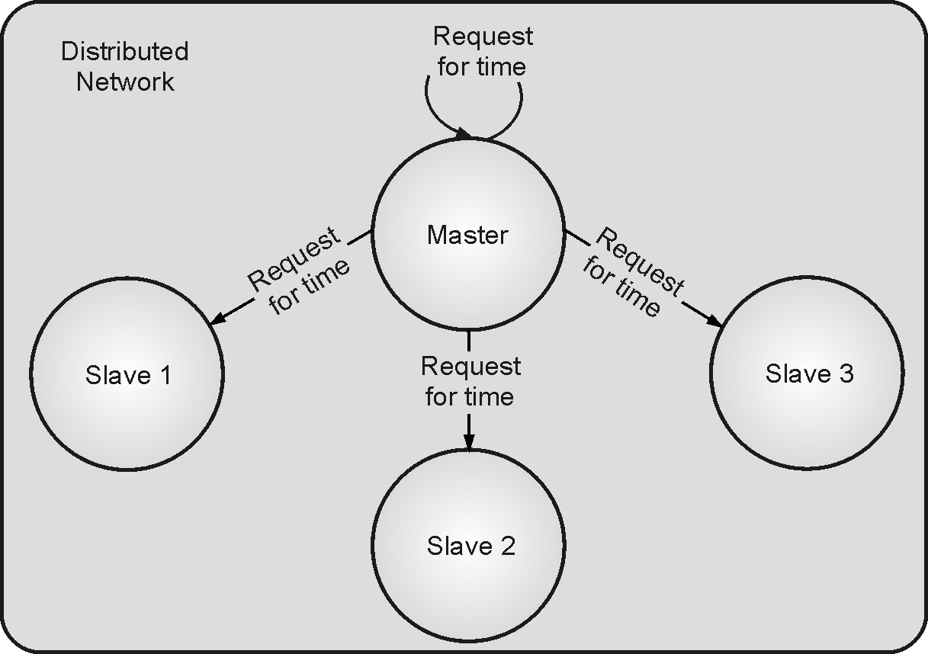
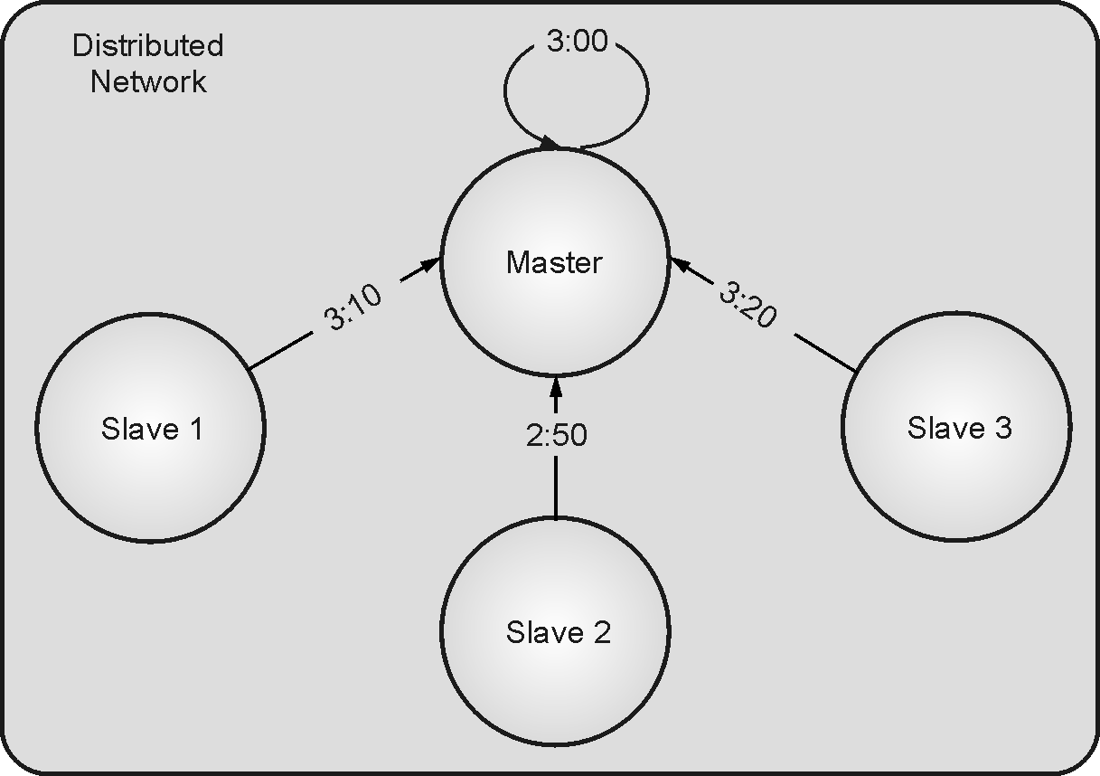
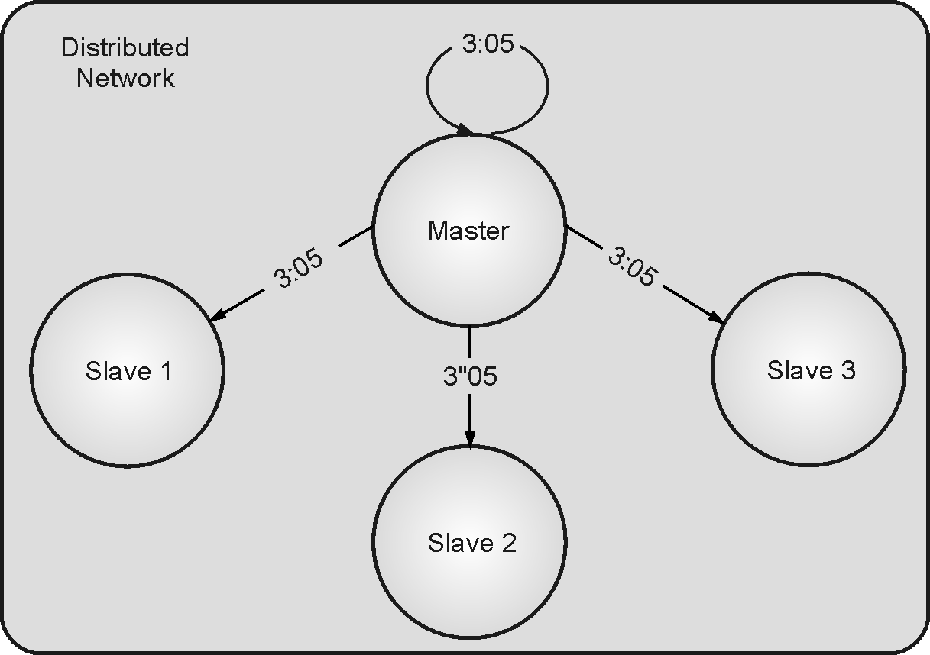
Fig. 3.2.3
Fig. 3.2.4
Fig. 3.2.5

Slide 10
(B) Distributed Algorithms
1. Global Averaging Algorithm
2. Localized Averaging Algorithm

Slide 11
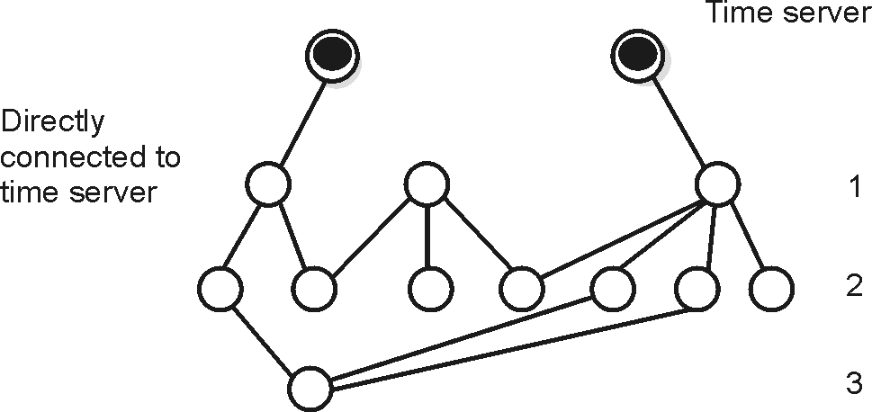
(C) Network Time Protocol (NTP)
Fig. 3.2.6 : Strata Synchronization Subnet

Slide 12
NTP servers synchronize with each other in one of the three modes:
(i) Multicast Mode :
(ii) Procedural Call Mode :
(iii) Symmetric Mode :

Slide 13
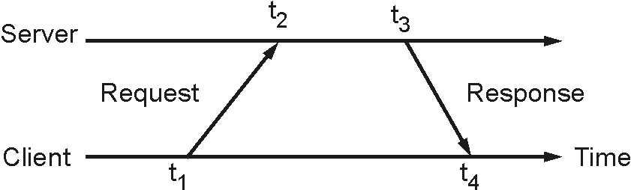
(D) Simple Network Time Protocol (SNTP)
Fig.3.2.7 : SNTP Synchronization

Slide 14
Logical Clocks

Slide 15
Lamport’s Scalar Clock
Rules of Lamport’s Logical Clocks:
(a) Happened Before Relation
If a & b are events in the same process and a occurs before b, then a→b.
If a & b belong to two different processes and a sends message to b, then a→b.
If a→b and b→c, then a→c.
(b) Logical Clocks Concept
Maintaining a common clock or set of perfectly synchronized clock is difficult.
So, local timestamp is given for happened before relation.

Slide 16
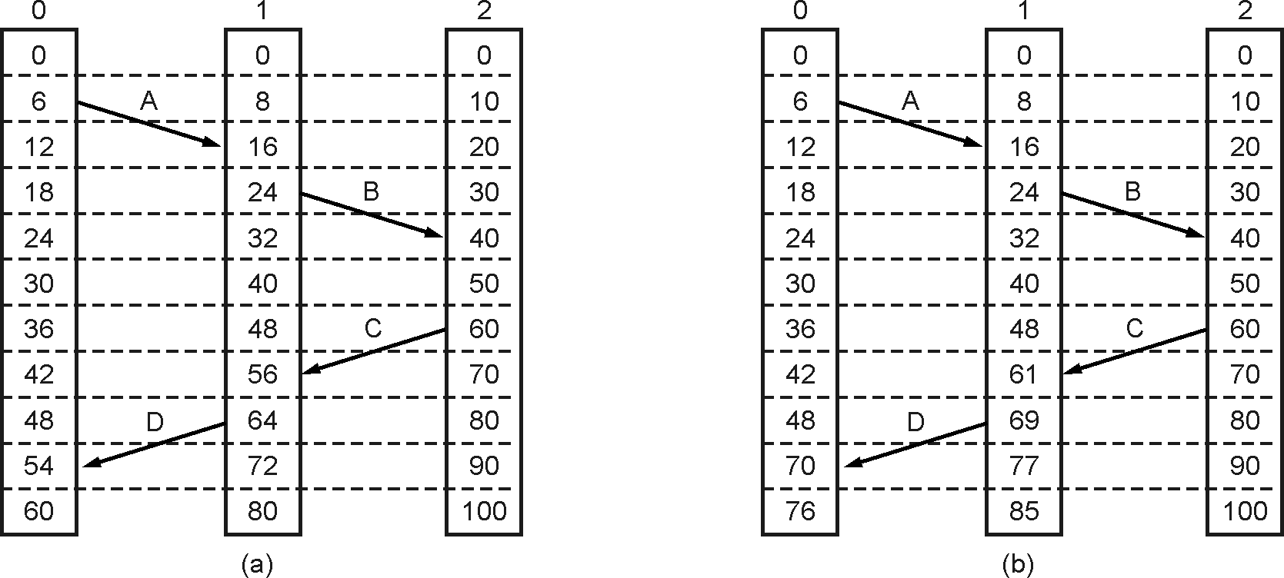
Fig. 3.3.1 : Event Ordering Example

Slide 17
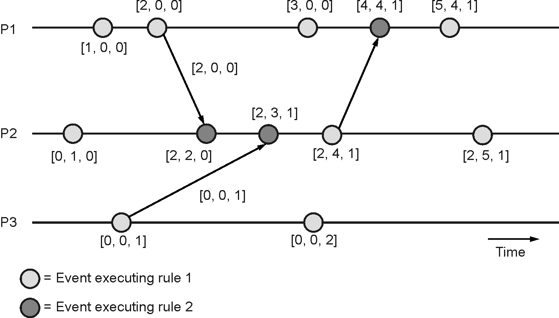
Vector Timestamp Ordering
Fig. 3.3.2 : Vector Clock Mechanism

Slide 18
Election Algorithms

Slide 19
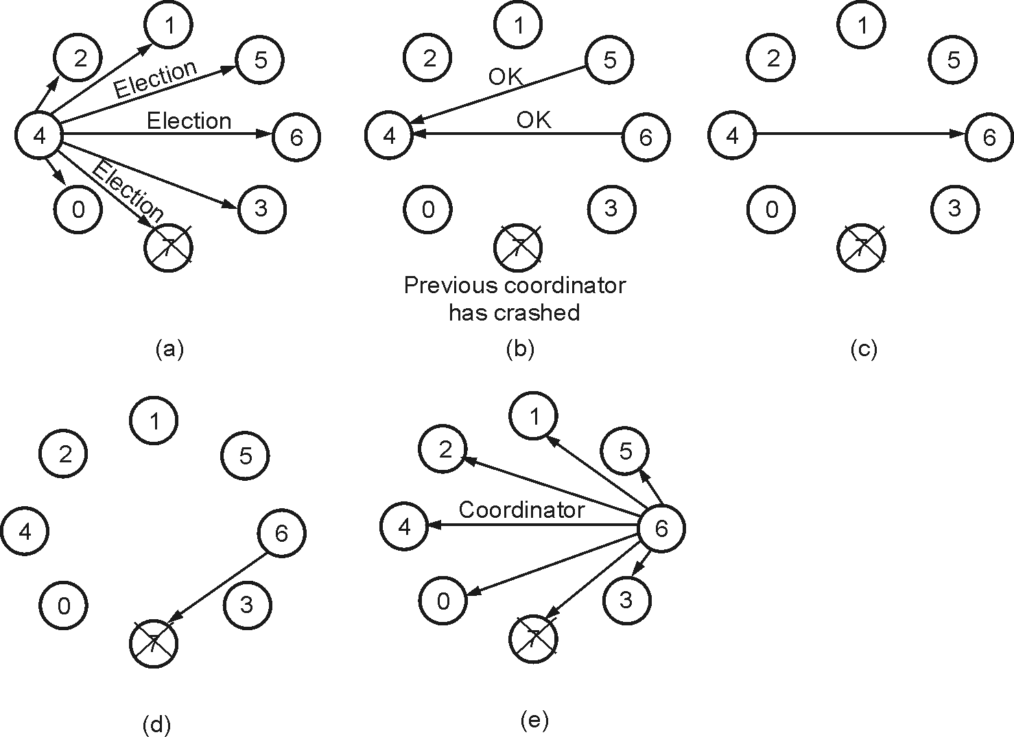
Bully Algorithm
Fig. 3.4.1 : Election Algorithm

Slide 20
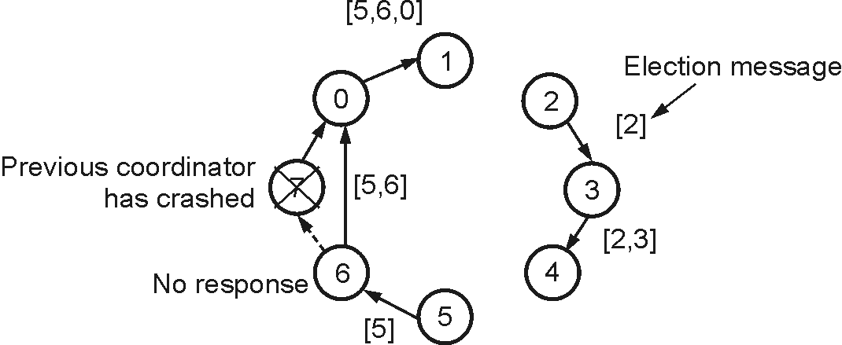
Ring Algorithm
Fig. 3.4.2 : Ring Algorithm

Slide 21
Mutual Exclusion
• Mutual Exclusion in Single Computer System : In single computer system, memory and other resources are shared between different processes. The status of shared resources and the status of users is easily available in the shared memory so with the help of shared variable (For example: Semaphores) mutual exclusion problem can be easily solved.
• Mutual Exclusion in Distributed Systems : In Distributed systems, we neither have shared memory nor a common physical clock and there for we cannot solve mutual exclusion problem using shared variables. To eliminate the mutual exclusion problem in distributed system approach based on message passing is used.A site in distributed system do not have complete information of state of the system due to lack of shared memory and a common physical clock.

Slide 22
Requirements of Mutual Exclusion Algorithm
Following are the requirements of mutual exclusion algorithms :
(i) No Deadlock : Two or more sites should not endlessly wait for any message that will never arrive.
(ii) No Starvation : Every site who wants to execute critical section should get an opportunity to execute it in finite time. Any site should not wait indefinitely to execute critical section while other sites are repeatedly executing critical section
(iii) Fairness : Each site should get a fair chance to execute critical section. Any request to execute critical section must be executed in the order they are made i.e.,critical section execution requests should be executed in the order of their arrival in the system.
(iv) Fault Tolerance : In case of failure, it should be able to recognize it by itself to continue functioning without any disruption.

Slide 23
Classification of Mutual Exclusion Algorithms
Mutual exclusion algorithms can be classified as :
1. Centralized Algorithm
2. Distributed Algorithm
3. Token Ring Algorithm

Slide 24
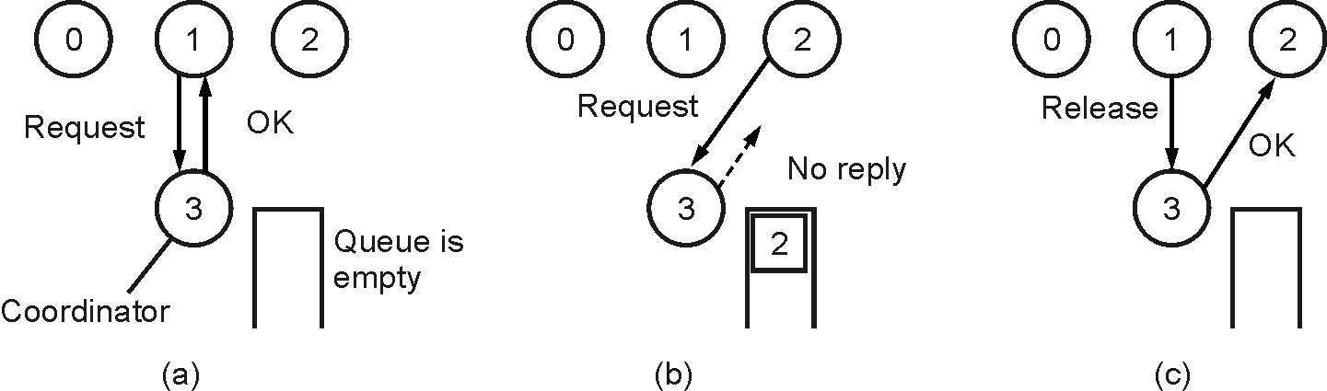
Fig. 3.5.1 : Centralized Algorithm

Slide 25
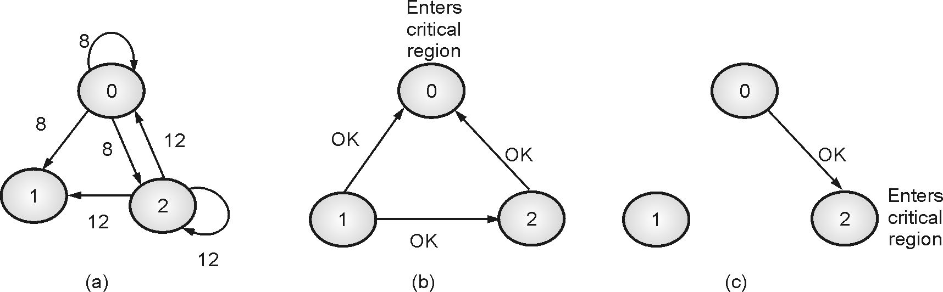
Fig. 3.5.2 : Distributed Algorithm

Slide 26
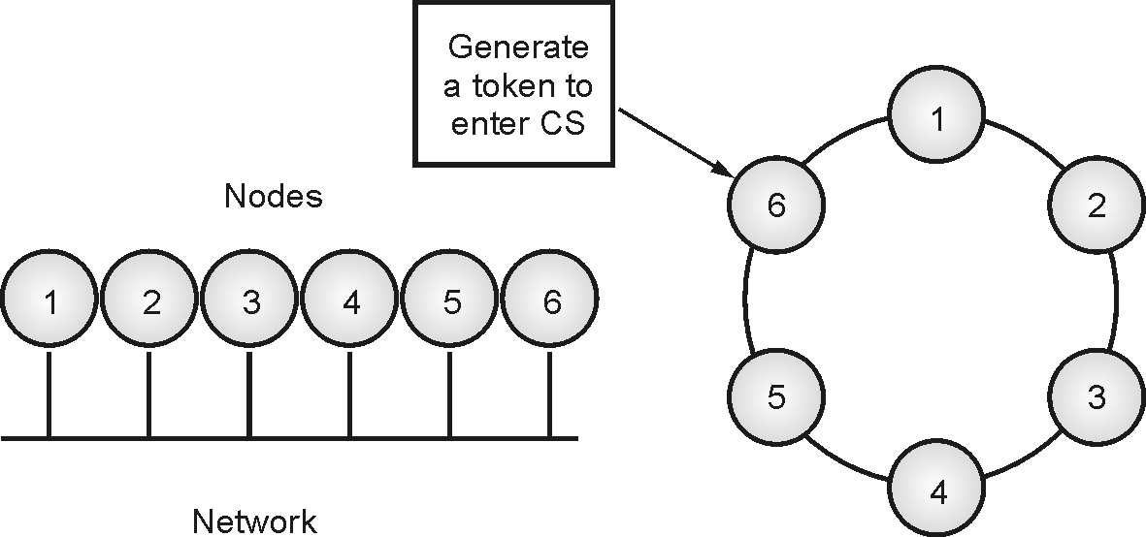
Fig. 3.5.3 : Logical ring of unordered node of the network

Slide 27
Comparison of Mutual Exclusion Algorithms
Algorithm | Messages per entry/exit | Delay before entry (in message times) | Problems
Centralized | 3 | 2 | Coordinator crash
Distributed | 2(n-1) | 2(n-1) | Crash of any process
Token Ring | 1 to ∞ | 0 to (n-1) | Lost token, process crash

Slide 28
Non-Token Based Algorithms
Lamport’s Algorithm

Slide 29
Maekawa’s Algorithm

Slide 30
Ricart–Agrawala Algorithm

Slide 31
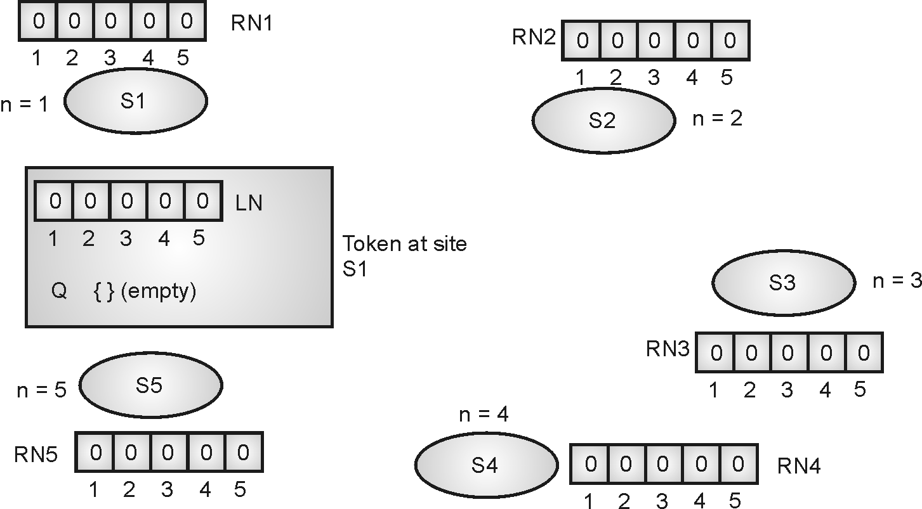
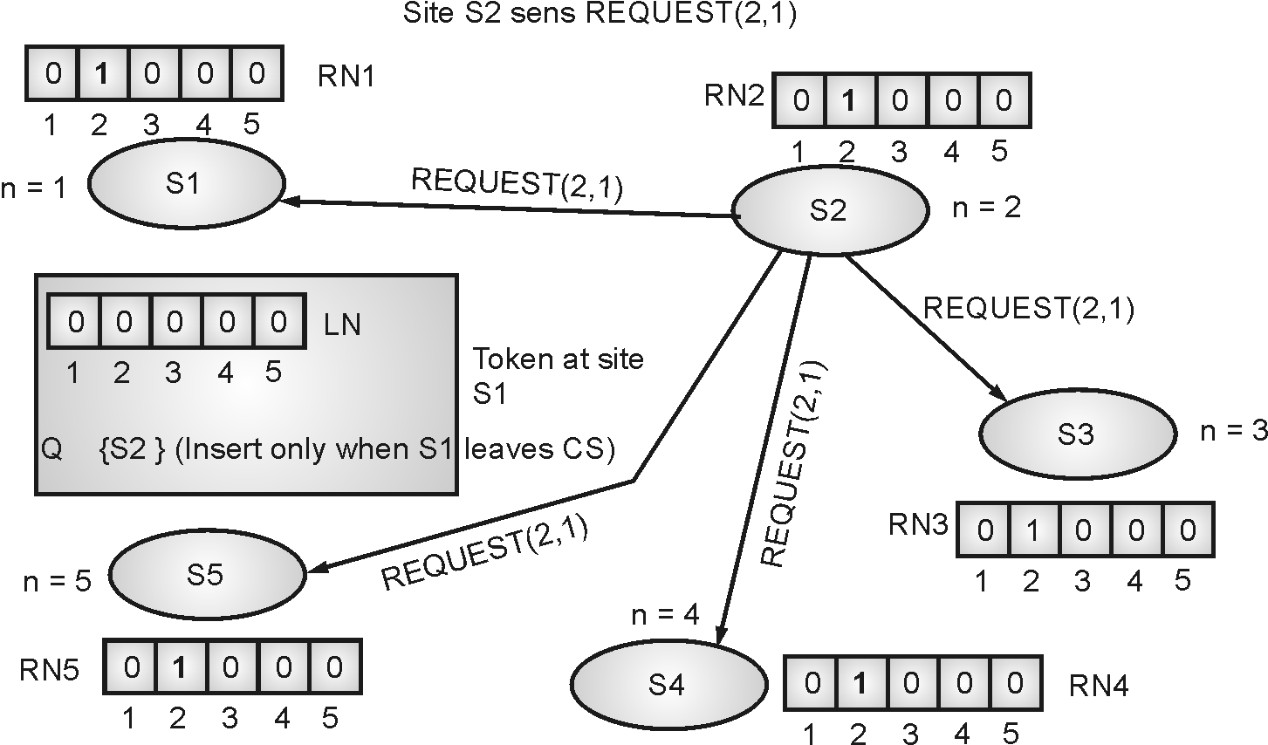
Token Based Algorithms
Suzuki-Kasami’s Broadcast Algorithm
Fig. 3.7.1
Fig. 3.7.2

Slide 32
Singhal’s Heuristic Algorithm

Slide 33
Raymond’s Tree-based Algorithm

Slide 34
Comparative Performance Analysis of Mutual Exclusion Algorithms
Algorithm | Type | Messages Complexity (High Load) | Messages Complexity (Low Load) | Synchronization Delay (SD) | System Throughput (ST) | Correctness Properties
Lamport’s Algorithm | Non-token based | 3(N-1) | 3(N-1) | T | 1/(T+E) | Safety, Fairness and Liveness
Ricart-Agrawala Algorithm | Non-token based | 2(N-1) | 2(N-1) | T | 1/(T+E) | Safety, Fairness and Liveness
Maekawa’s Algorithm (N is quorum size) | Token based, Quorum based | 5 | 3 | 2T | 1/(2T+E) | Safety, Fairness, but no Liveness
Suzuki-Kasami’s Algorithm | Token based, broadcast | 0 (If the requesting site holds the token) | N | 0 or T | 1/(T+E) | Safety, Liveness, Unfair SD and Message complexity high if N is large
Singhal’s Dynamic Algorithm | Token based, heuristic | 3(N-1)/2 | (N-1) | T | 1/(T+E) | Safety, Fairness and Liveness
Raymond’s Tree Based Algorithm (k is depth) | Token based, tree based | 4 | logN | T(logN)/2 | 1/(T+E) | Safety, Fairness and Liveness

Slide 35
Comparison of Token based and Non-token based Mutual Exclusion Algorithms
Sr.No. | Token Based Algorithms | Non-Token Based Algorithms
1. | In the Token-based algorithm, a unique token is shared among all the sites in Distributed Computing Systems. | In Non-Token based algorithm, there is no token even not any concept of sharing token for access.
2. | Here, a site is allowed to enter the Critical Section if it possesses the token. | Here, two or more successive rounds of messages are exchanged between sites to determine which site is to enter the Critical Section next.
3. | The token-based algorithm uses the sequences to order the request for the Critical Section and to resolve the conflict for the simultaneous requests for the System. | Non-Token based algorithm uses the timestamp (another concept) to order the request for the Critical Section and to resolve the conflict for the simultaneous requests for the System.
4. | The token-based algorithm produces less message traffic as compared to Non-Token based Algorithm. | Non-Token based Algorithm produces more message traffic as compared to the Token-based Algorithm.
5. | They are free from deadlock (i.e. here there are no two or more processes are in the queue in order to wait for messages that will actually can’t come) because of the existence of unique token in the distributed system. | They are not free from the deadlock problem as they are based on timestamp only.

Slide 36
Comparison of Token based and Non-token based Mutual Exclusion Algorithms
6. | Here, it is ensured that requests are executed exactly in the order as they are made in. | Here there is no surety of execution order.
7. | Token-based algorithms are more scalable as they can free your server from storing session state and also, they contain all the necessary information which they need for authentication. | Non-Token based algorithms are less scalable than the Token-based algorithms because server is not free from its tasks.
8. | Here the access control is quite Fine-grained because here inside the token roles, permissions and resources can be easily specifying for the user. | Here the access control is not so fine as there is no token which can specify roles, permission, and resources for the user.
9. | Token-based algorithms make authentication quite easy. | Non-Token based algorithms can’t make authentication easy.
10. | Examples of Token-Based Algorithms are: (i) Singhal’s Heuristic Algorithm (ii) Raymonds Tree Based Algorithm (iii) Suzuki-Kasami Algorithm | Examples of Non-Token Based Algorithms are: (i) Lamport’s Algorithm (ii) Ricart-Agarwala Algorithm (iii) Maekawa’s Algorithm

Slide 37
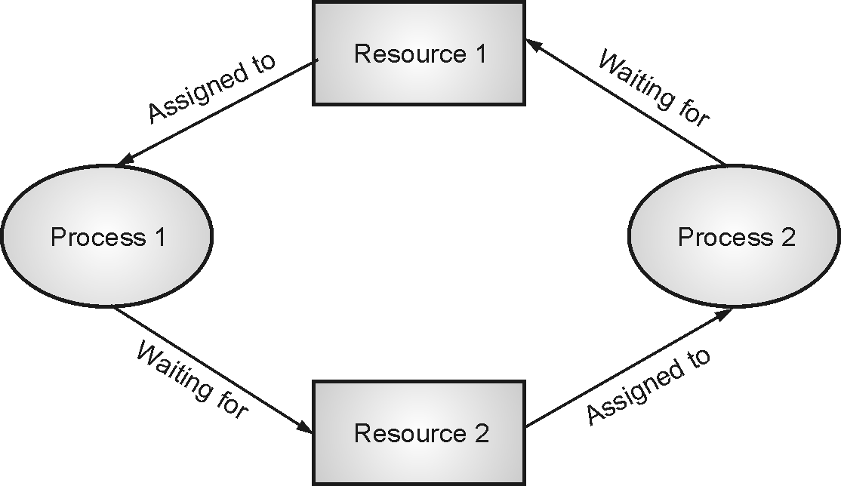
Deadlock
Three commonly used strategies to handle deadlocks are as follows
(i) Avoidance
(ii) Prevention :
(iii) Detection and recovery :
Fig. 3.9.1 : Deadlock Scenario

Slide 38
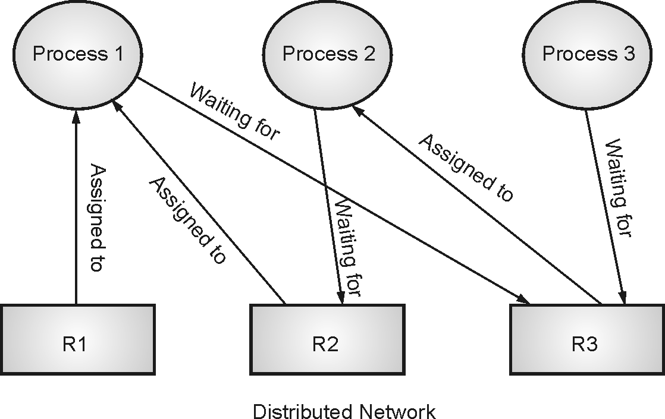
Types of Distributed Deadlock
1. Resource Deadlock :
Fig. 3.9.2 : Resource Deadlock

Slide 39
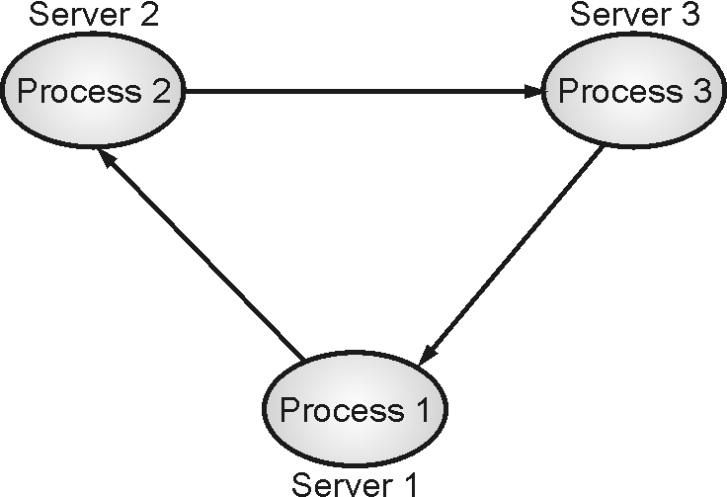
Types of Distributed Deadlock
Communication Deadlock :
Fig. 3.9.3 : communication Deadlock

Slide 40
Chandy-Misra-Hass Algorithm

Slide 41
Thank you!!!
Ashok.patade@djsce.ac.in

